Slide 1


“STARTALK: Understanding the ACTFL Guidelines”
Meg Malone | Todd H. McKay | Amy Kim

Slide 2


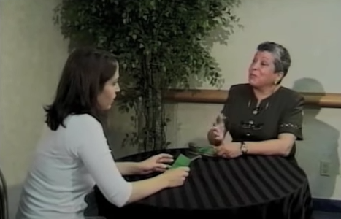
Background
Instructors increasingly called to develop tests to assess students despite limited assessment training (Taylor, 2009).
Training is essential, but PD is scarce for in-service instructors (Malone, 2013); in-service PD programs must pick up slack (Popham, 2009).
ACTFL Guidelines big in U.S. (Chalhoub-Deville & Fulcher, 2003), little PD to give in-service instructors ACTFL Guidelines training.

Slide 3
Introduction
help HIGHER ED INSTRUCTORS of
critical languages understand the
ACTFL Proficiency Guidelines and how to incorporate them into a
proficiency-based program and
their own curricula

Slide 4
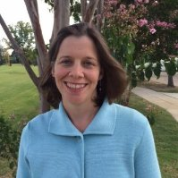
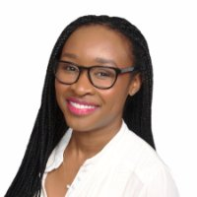
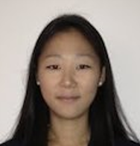
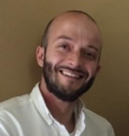
Project team
Dr. Meg
Malone
Josephine
Onah
Amy
Kim
Todd
McKay

Slide 5

Participants
INSTRUCTORS
19

Slide 6
Participants
INSTRUCTORS
16
19
Community College 1
LCTLs
mostly East Coast 12
Mandarin 6
Portuguese 4
RUSSIAN, HINDI 1
Arabic 4

Slide 7




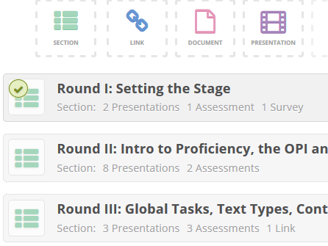
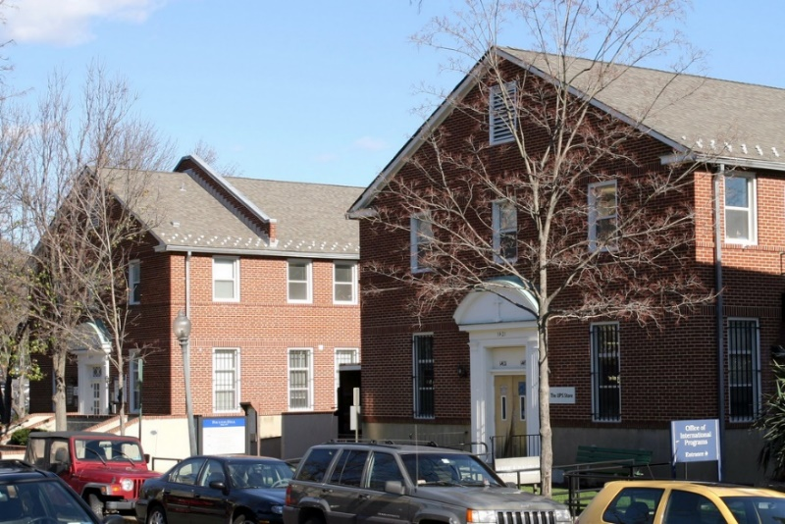



Program overview
ONLINE
WORKSHOP
JUN
JUL
SEP
NOV
JAN

Slide 8
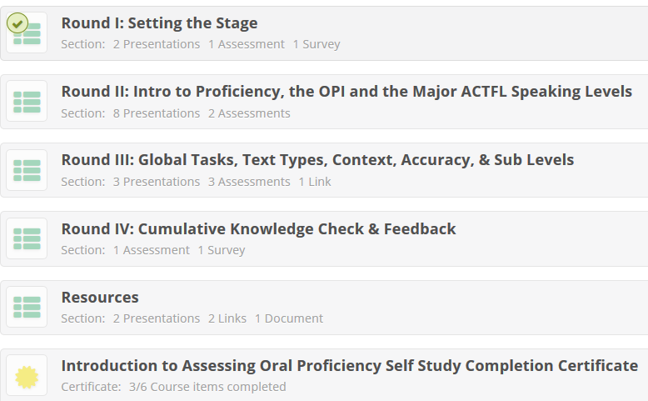
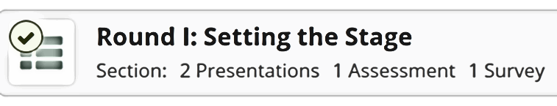



Course content
MAJOR SECTIONS

Slide 9



Course content
Overview
Background
Discuss
√

Slide 10
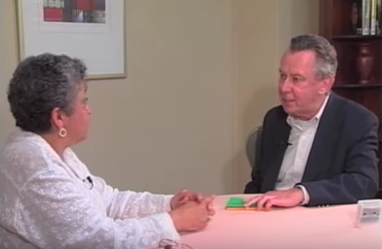

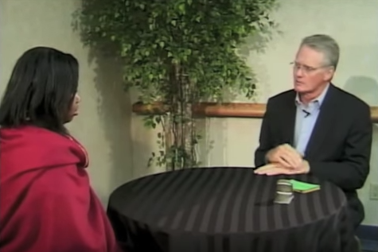


Course content
Guidelines
OPI
Levels
Discuss
√

Slide 11
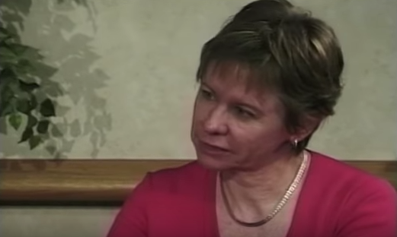




Course content
√
Global
tasks
Context
Content
Watch n’
rate
Sublevels
√

Slide 12




Course content
√
Self study
Certificate
Resources

Slide 13

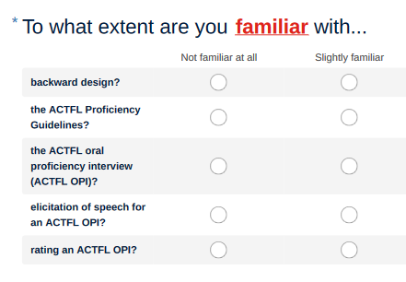
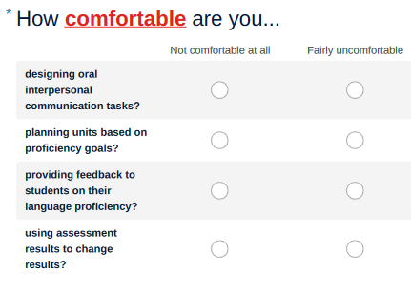


Methods
CONTENT

Slide 14
Methods
CONTENT

Slide 15


Methods
FORMAT
1
2
3
4
LMS → easy to use
Ready 4 F2F?
Good info about Guidelines
Relevant info about OPI
Quizzes were formative
Presentations → clear
Videos → helpful
Know more?

Slide 16
Methods
MCQs
Tru/Fa
Match

Slide 17
Methods
“Proficiency” is the ability to use language to communicate meaningful information in ________________.
MCQs
Tru/Fa
spontaneous interaction
Match

Slide 18
Methods
The ACTFL Guidelines describe how an individual should learn language.
MCQs
Tru/Fa
Match

Slide 19
Methods
Match the following major levels of the ACTFL
Speaking Scale
with their descriptors.
MCQs
Tru/Fa
Match

Slide 20


Methods
Descriptives

Slide 21




How familiar are you with…
N = 16
Backward design
56%
70%
ACTFL Guidelines
63%
80%
ACTFL OPI
52%
75%
Eliciting speech
44%
70%
Rating an OPI
47%
73%

Slide 22
About the online course…
N = 14
Relevant info on OPI
100%
Good info on AG
93%
Ready 4 F2F?
93%
Know more now?
100%

Slide 23
About the online course…
N = 14
LMS → easy to use
57%
Quizzes → formative
71%
PPTs → clear
100%
Videos → helpful
100%

Slide 24

About the online course…
88%
60%
82%
59%

Slide 25

Program overview
JUNE
ONLINE
WORKSHOP
TO
JULY

Slide 26
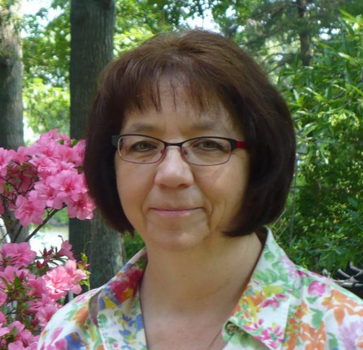


Workshop content
DAY 1
DAY 2
DAY 3
Intro to rating scale
CLASSROOM, CURRICULAR IMPLICATIONS
VIEW AND RATE VIDEOS
OPI structure
LIVE VOLUNTEERS!
PRACTICE WARM-UP, SPIRALING, ELICITION
breakout sessions
LIVE VOLUNTEERS!
WORKSHOP EVALUATION

Slide 27

Methods

Slide 28
Methods

Slide 29
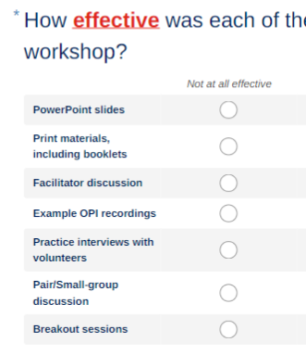
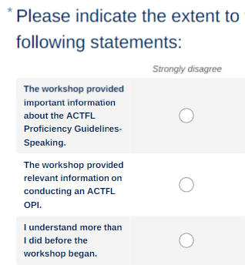
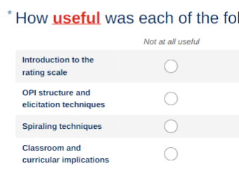
Methods

Slide 30
Methods
1
2
3
4
5

Slide 31
Methods
1
2
3
4
5
What is working well with regard to program management and logistics?

Slide 32
Methods
1
2
3
4
5
What is working well with regard to instructional design?

Slide 33
Methods
1
2
3
4
5
What recommendations are being made for the current year?

Slide 34
Methods
1
2
3
4
5
What opportunities are there for continued improvement with regard to program management or logistics?

Slide 35
Methods
1
2
3
4
5
What opportunities are there to improve instructional planning and practice?

Slide 36
Methods
Descriptives
Comments

Slide 37
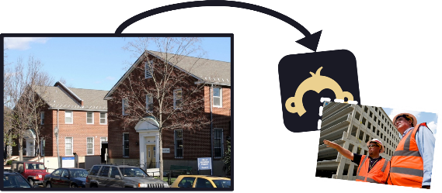
How familiar are you with…
N = 16
Backward design
56%
73%
ACTFL Guidelines
63%
89%
ACTFL OPI
52%
89%
Eliciting speech
44%
88%
Rating an OPI
47%
84%

Slide 38



How comfortable are you…
N = 14
Designing IC tasks
70%
86%
Planning units
69%
80%
Giving feedback
81%
84%
Results for change
77%
80%

Slide 39
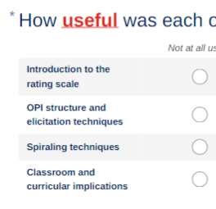
Other questionnaire results
89–91%
84–96%
95–96%

Slide 40

Methods
1
What is working well with regard to program management and logistics?
PROGRAM IS WELL ORGANIZED
Online component frontloads concepts to maximize face-to-face time

Slide 41
Methods
2
What is working well with regard to instructional design?
EXCELLENT MATERIALS GIVEN ONLINE, ON SITE
Hands-on practice with interviewees
Online, F2F parts → complementary

Slide 42
Methods
3
What recommendations are being made for the current year?
More pair work…change teams for variation
More ‘we-do’ scaffolding activities
to facilitate ‘you-do’ activities

Slide 43
Methods
4
What opportunities are there for continued improvement regarding program management or logistics?
Continue recruitment of community college instructors, particularly those responsible for developing language majors seeking teaching certification.

Slide 44
Methods
5
What opportunities are there to improve instructional planning and practice?
Use a ‘look-for’ sheet with OPI videos
Consider having one synchronous session before F2F component
TL interviewees (or Skype with TL mentor)

Slide 45
Stay tuned
ONGOING!
(LOOKING GOOD SO FAR)
(SOME ATTRITION)
SEP
NOV
JAN

Slide 46
THANKS!

Slide 47


Slide 48
“
“
Ꙭ
√

Slide 49


Slide 50





$$$

Slide 51





Slide 53

STARTALK teacher consent!
https://www.surveymonkey.com/r/STARTALK_Teacher_Consent

